Slide 1
Lecture 17: MRI System and Applications
Dr. Guohua Cao （曹国华） caogh@shanghaitech.edu.cn
School of Biomedical Engineering
ShanghaiTech University
5/22/2024

Slide 2
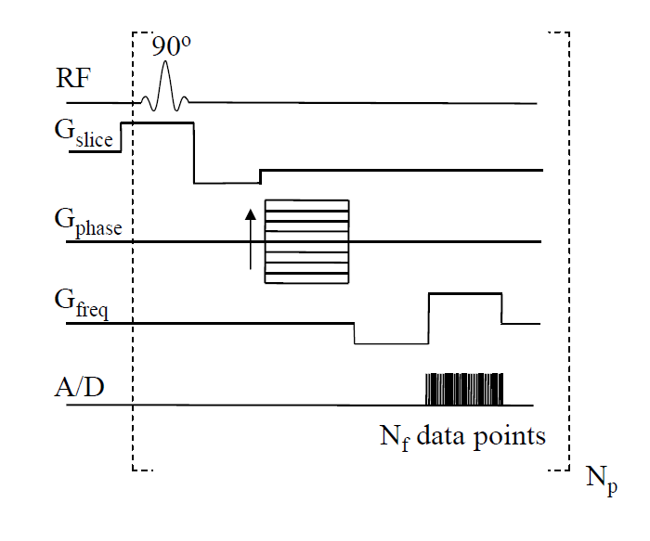
RF pulse and Gradient pulses

Slide 3
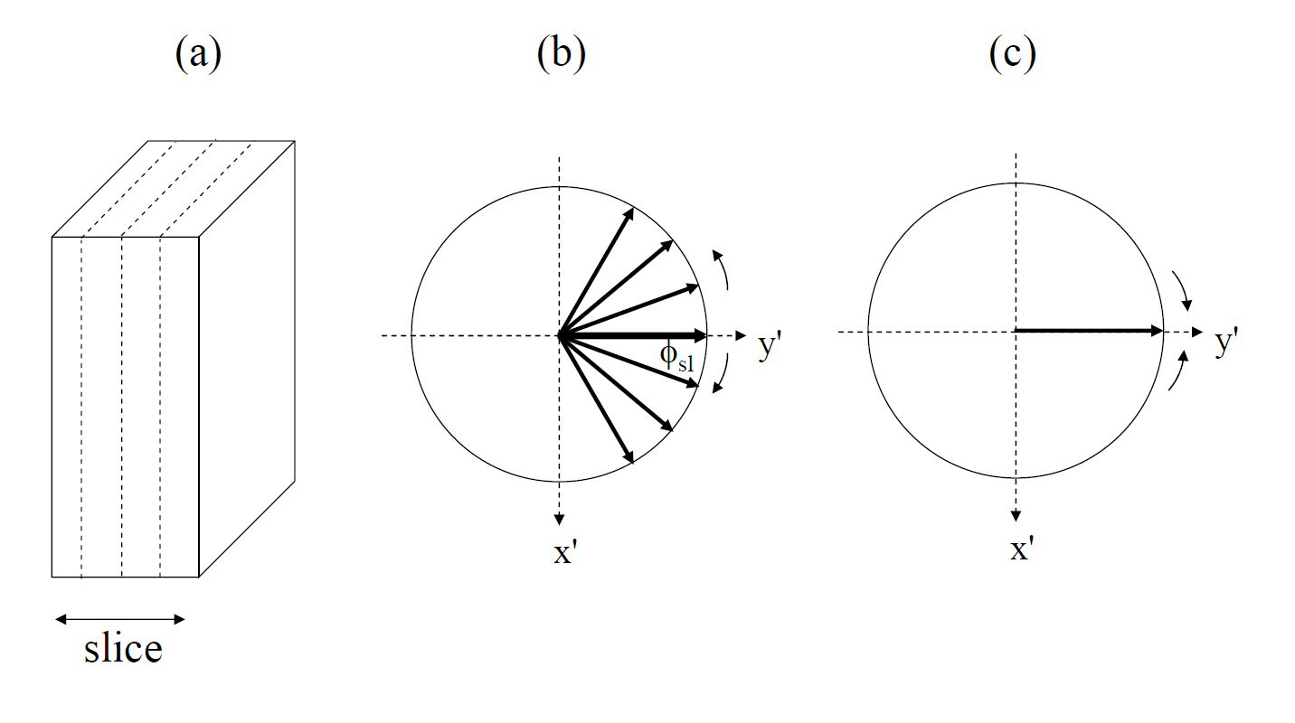
phase
frequency

Slide 4
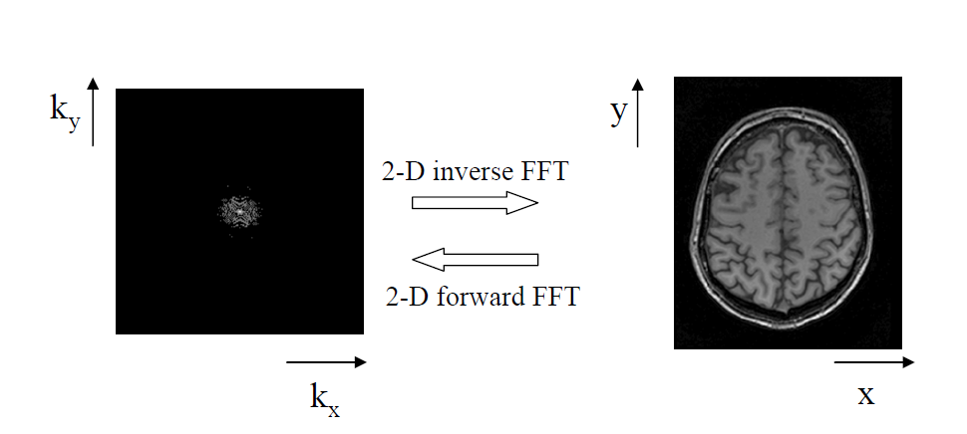

Slide 5
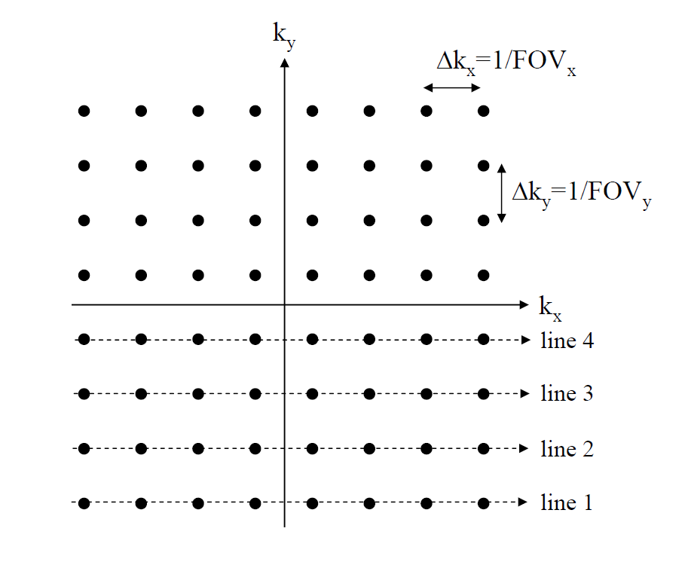

Slide 6
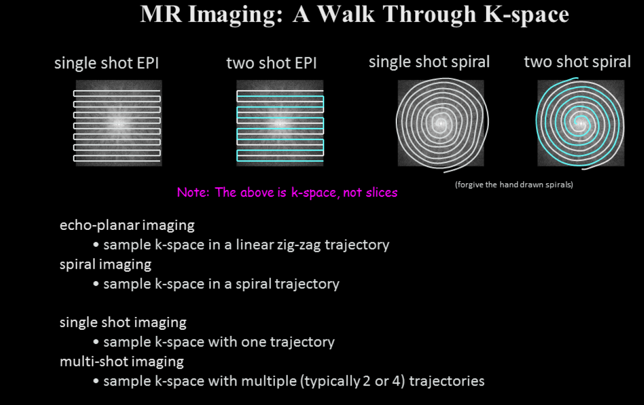
EPI

Slide 7
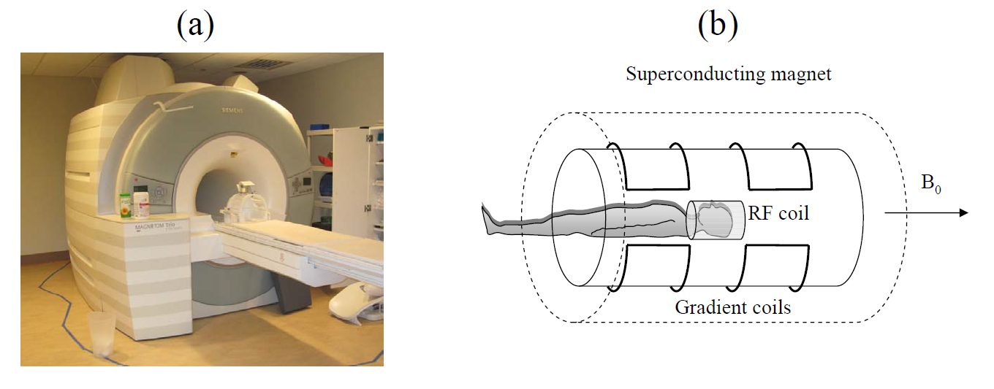
MRI Scanner
MRI hardware:
Superconducting magnet
3 magnetic field gradient coils
Radiofrequency transmitter and receiver

Slide 8
Superconducting Magnet
Superconducting wire has a resistance approximately equal to zero when it is cooled to a temperature close to absolute zero .
The length of superconducting wire in the magnet is typically several miles.
The coil of wire is kept at a temperature of 4.2K by immersing it in liquid helium. The coil and liquid helium is kept in a large dewar. The typical volume of liquid Helium in an MRI magnet is 1700 liters.
There is usually a refrigerator outside the magnet with cooling lines going to a cold head in the liquid helium.

Slide 9
Another advance in magnet technology is active shielding of the magnet. The shielding is achieved by a second set of superconducting windings, outside of the main ones and with opposite current. - smaller fringe field - important for safety reasons , and makes it easier to site a magnet.

Slide 10
Gradient Coils
The gradient coils produce the gradients in the Bo magnetic field.
A gradient in Bo in the Z direction is achieved with an anti-Helmholtz type of coil. Current in the two coils flow in opposite directions creating a magnetic field gradient between the two coils. The B field at one coil adds to the Bo field while the B field at the center of the other coil subtracts from the Bo field.

Slide 11
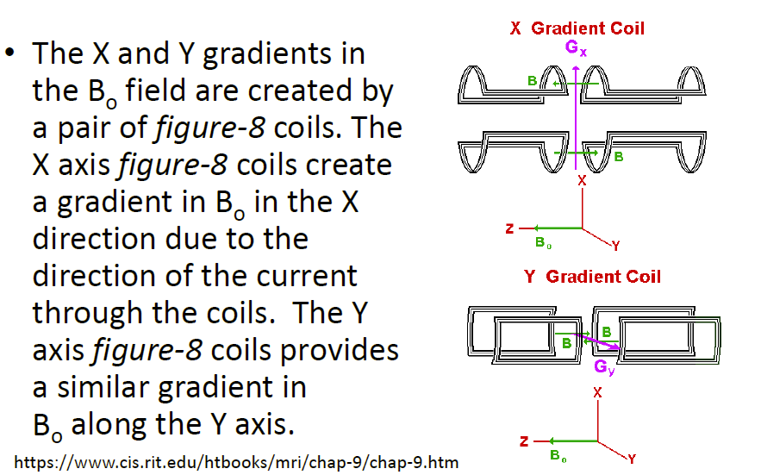
Gradient Coils

Slide 12
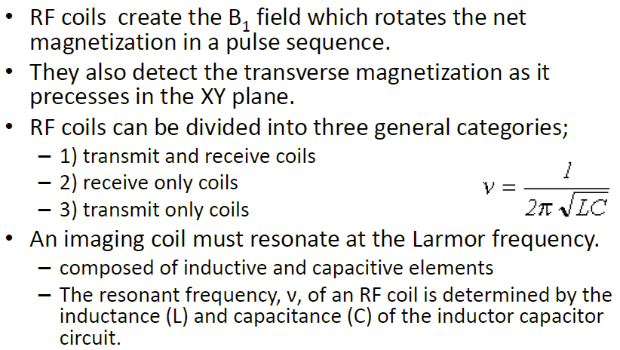
RF Coils
Phased-array

Slide 14
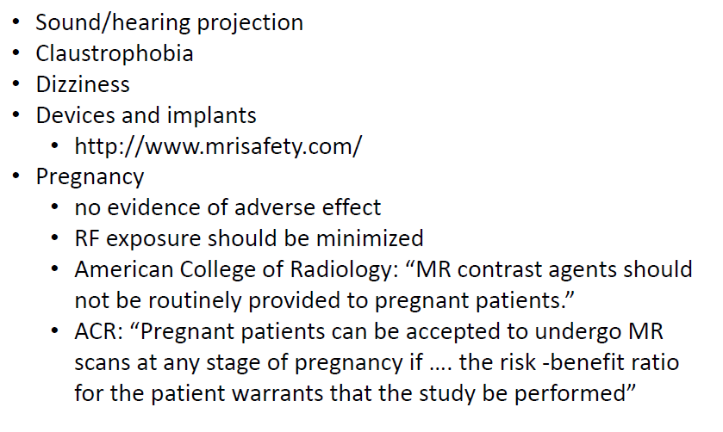
MRI Safety
Gradient switches produce Lorentz forces causing vibrations in the gradient coils and their supports. These vibrations are the main source of the characteristic MRI noise.

Slide 15
Types of MRI Applications
Structural Imaging (magnetic property)
‐ Proton, T1w, T2w, …
Angiography (vessel imaging)
‐ time‐of‐flight, phase contrast, w/ contrast
Diffusion imaging
Perfusion imaging
‐ DSC, DCE, ASL
Functional MRI (BOLD)
Spectroscopy

Slide 16

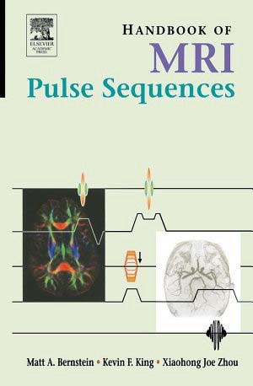

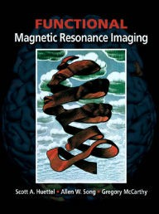
References
Bushberg et al.
Bernstein et al.
Buxton
Huettel et al.

Slide 17
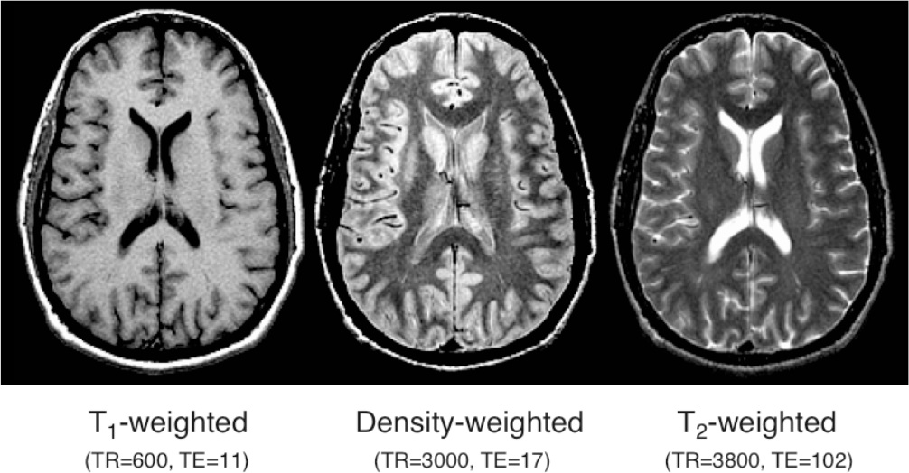
Magnetic Characteristics of Tissues
Buxton, Figure 7.3

Slide 18
MR Angiography (MRA)

Slide 19
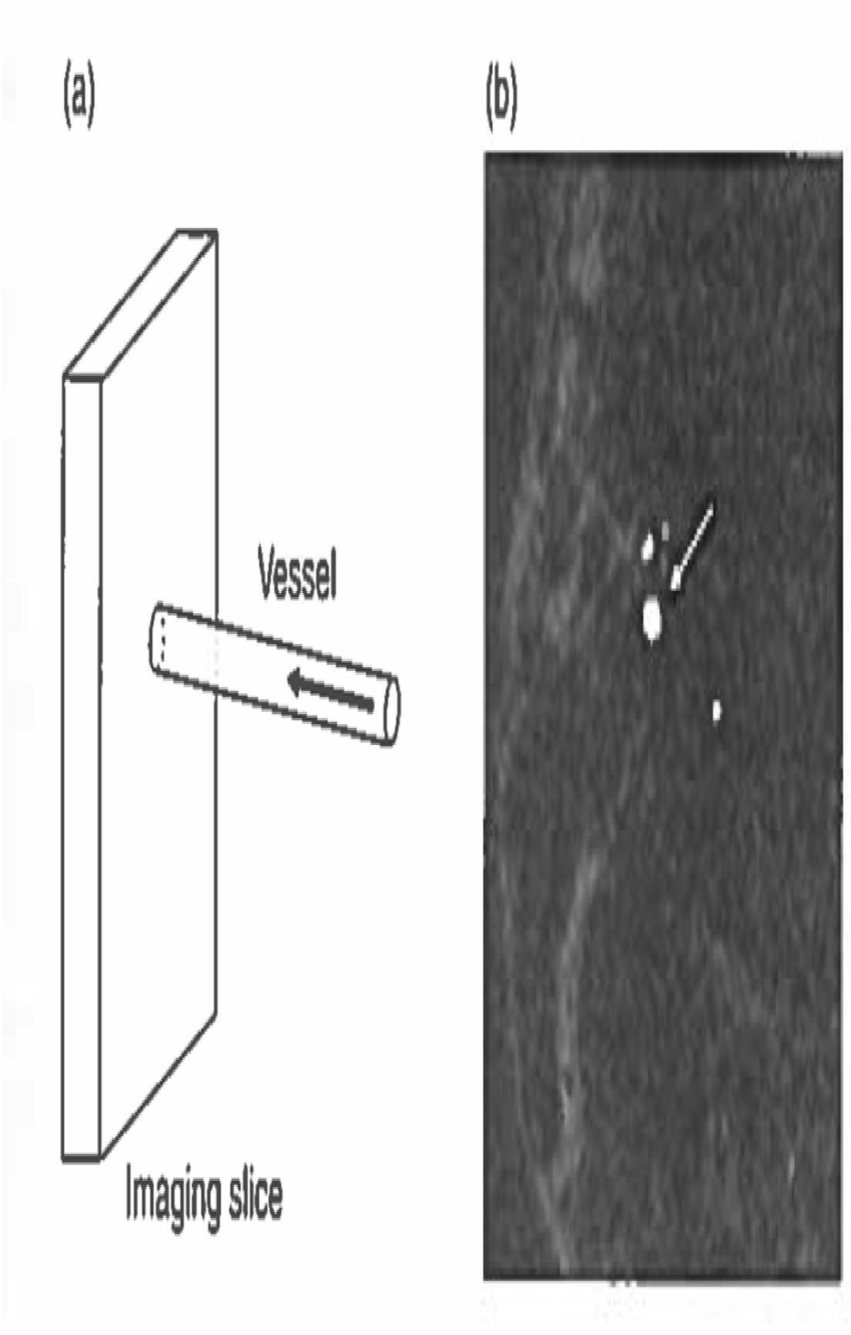
Time‐of‐Flight
Bernstein et al. Figure 15.17

Slide 20
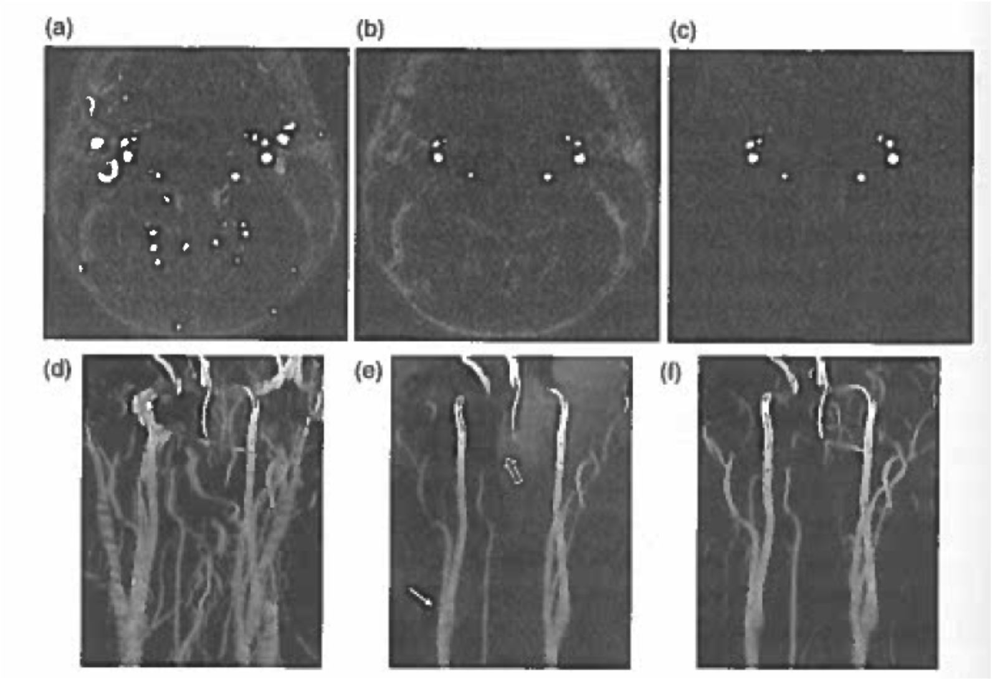
Time‐of‐Flight
Bernstein et al. Figure 15.19
Example: https://www.youtube.com/watch?v=SjTSx5R554o

Slide 21
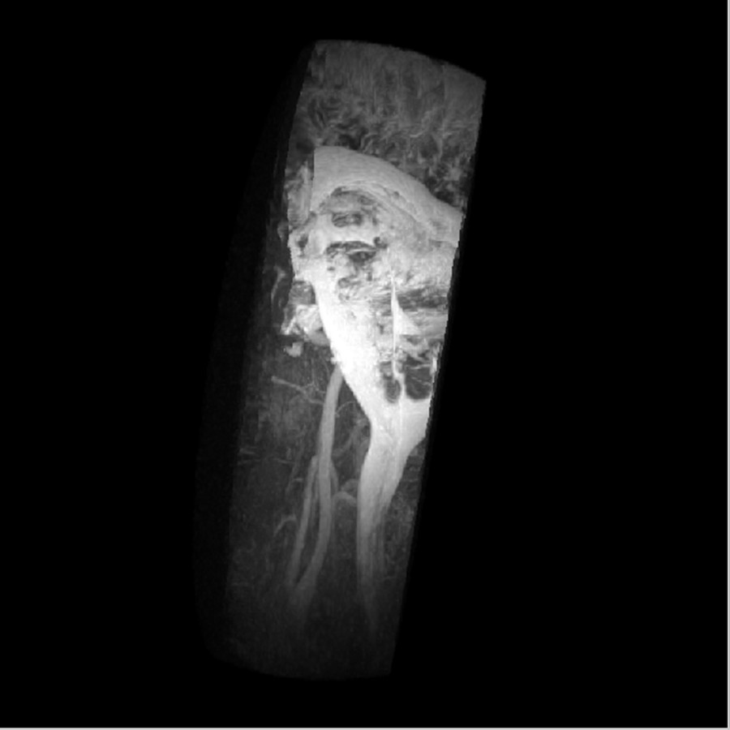
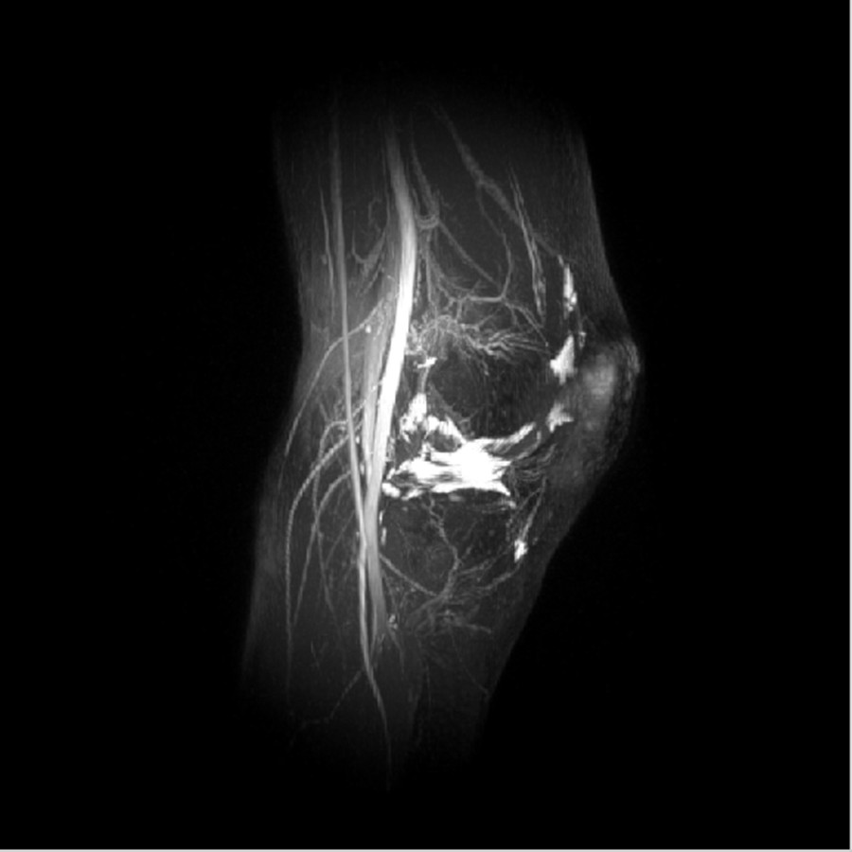
Steady‐State Free Precession

Slide 22
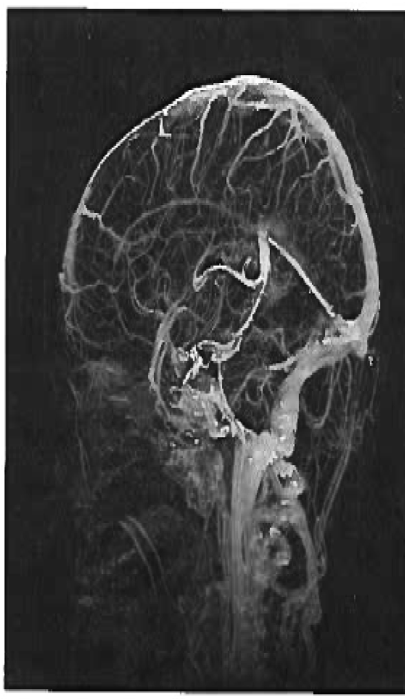

Contrast Enhanced MRA
https://www.youtube
.com/watch?v=0A3et EFuP5E
knee_lcssfp.avi
Bernstein et al. Figure 15.24

Slide 23
Diffusion Imaging

Slide 24
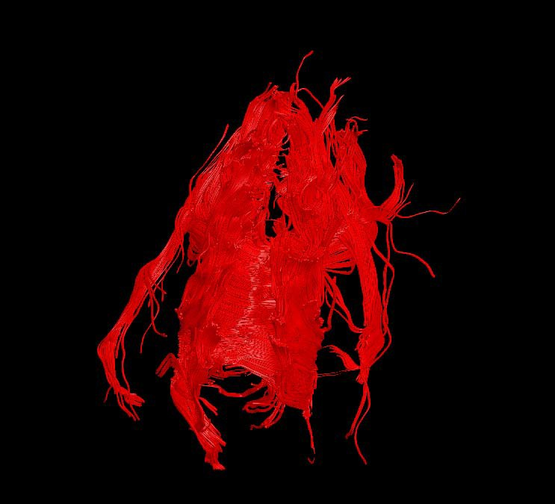
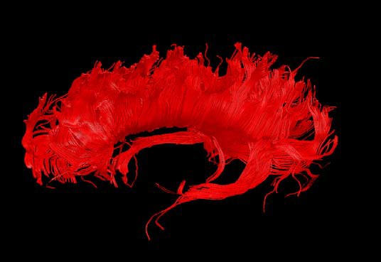
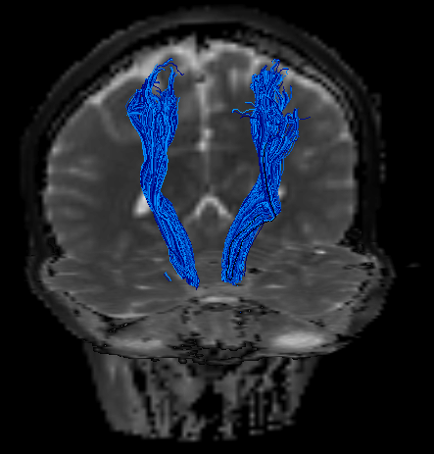
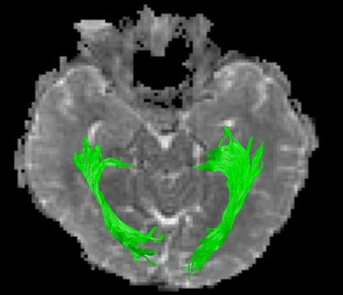
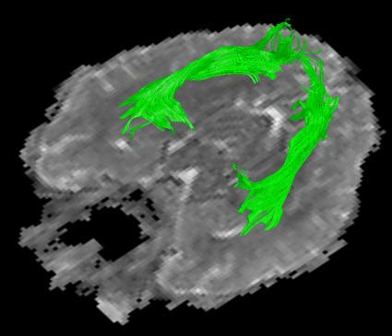
Fiber tracking
corpus callosum
Cortico-spinal tracts
optic radiations

Slide 25
Perfusion MRI

Slide 26
Arterial spin labeling (ASL)
Arterial spin labeling (ASL) is a non-invasive MRI technique to measure cerebral blood flow (CBF).
The goal of ASL MRI perfusion is to produce a “flow labeled image or tag image” and a “control image” in which the static tissue signals are identical, but the magnetization of the inflowing blood is different. In this technique, arterial blood water is magnetically tagged before it enters the tissue of interest.

Slide 27
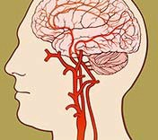

Pulsed ASL
with QUIPPS II or Q2TIPS
180° 90°
PICORE, FAIR, or EPISTAR
RF
Time 0
Imaging
TI1
~0.6s
TI2
M₀
Control Tag
SIantvuerrastioionn
TI2-TI1 TI2
t
~10 cm
‐M₀

Slide 28


Continuous ASL
Flow driven adiabatic inversion
RF
Time
Imaging
0
τ
~1.6s
TI
Control
M₀
Tag
M₀
TI-τ T
I
TI2^{t} -TI1 TI2
t
‐M₀
CASL
t: 1.6sec TI: 2.6sec
‐M₀
PASL
TI1: 0.6sec TI2: 1.6sec
SNR efficiency≈ x2
Additional RF system or
AM method (69% tagging efficiency)

Slide 29
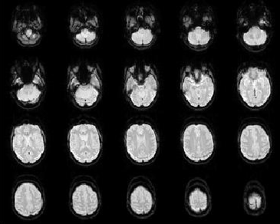
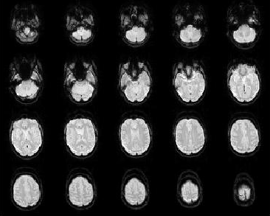
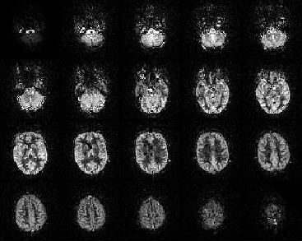
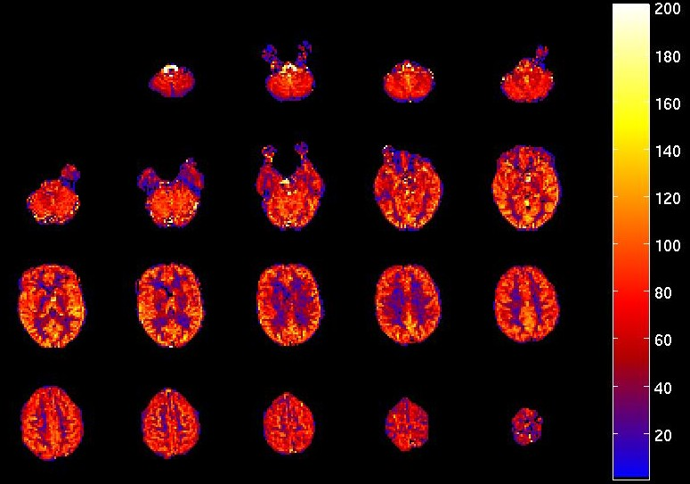
Arterial Spin Labeling
-
Control
Label
=
Quantifi cation
Perfusion weighted
Cerebral Blood Flow

Slide 30
Functional MRI (fMRI)

Slide 31
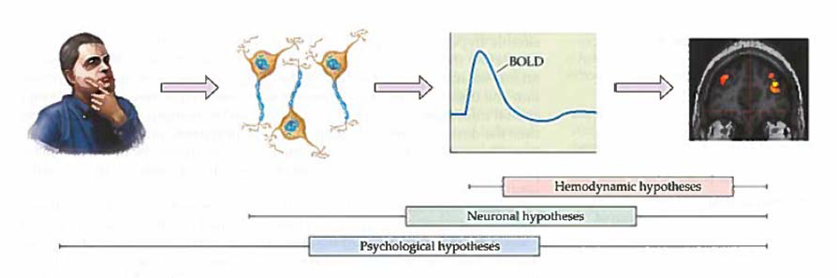
Blood oxygenation level dependent (BOLD) imaging - standard functional MRI (fMRI)
Huettel, et al., Figure 11.3

Slide 32
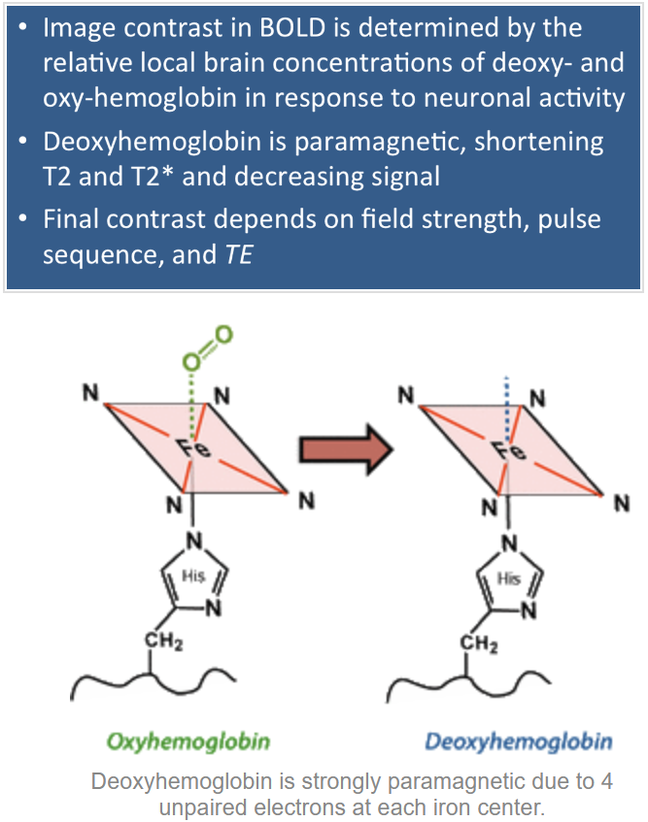
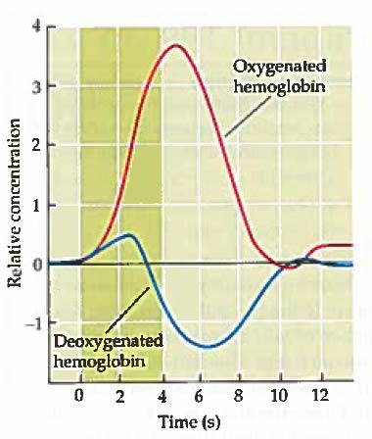
BOLD (Blood Oxygen Level Dependent) contrast
Huettel, et al. Figure 7.5 &7.16

Slide 33
MR Spectroscopy (MRS)

Slide 34
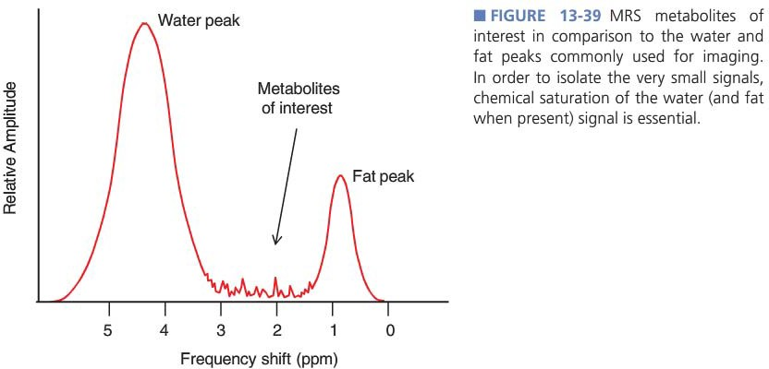
MR Spectroscopy

Slide 35
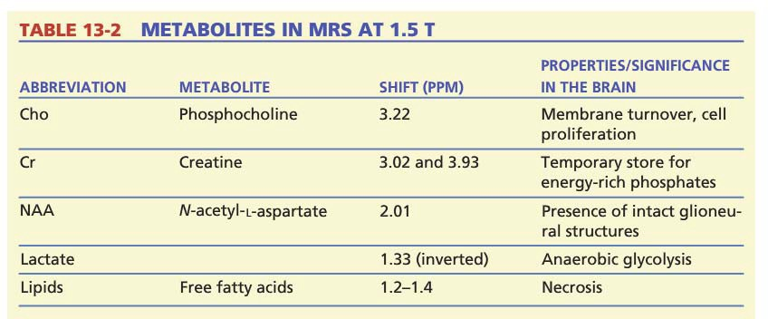
MRS Metabolites

Slide 36
Review on MRI Imaging
What determines the precession frequency of resonance?
gyromagnetic ratio
field strength
How do we detect a signal?
an applied rf-pulse can tip the bulk magnetization
can detect changing magnetization in transverse plane
What happens to the MR signal in the transverse plane?
it precesses to generate a signal
signal decays with 2 relaxation rates, T1 and T2
How is the NMR signal spatially encoded?
with magnetic field gradients
(e.g. slice select, phase encode, and frequency encode)

